Slide 1
Framing
Framing in the data link layer separates a message from one source to a destination
To service network layer , DLL uses the service provided to its physical layer
Physical layer accepts the raw bit streams and delivers it to the destination.
The DLL breaks the streams into discrete frames and computes the checksum for each frame
All the destination checksum are recomputed
Breaking of bits stream by inserting spaces or time gap is called framing

Slide 2
Fixed –Size Framing
Frames can be of fixed or variable size
In fixed size framing , there is no need for defining the boundaries of the frames
The size itself can be used as a delimiter
ATM is the example of fixed size framing

Slide 3
Variable Size Framing
In variable size framing end of the frame and beginning of the next frame is defined
Two methods are used
Character Oriented
Bit oriented

Slide 4
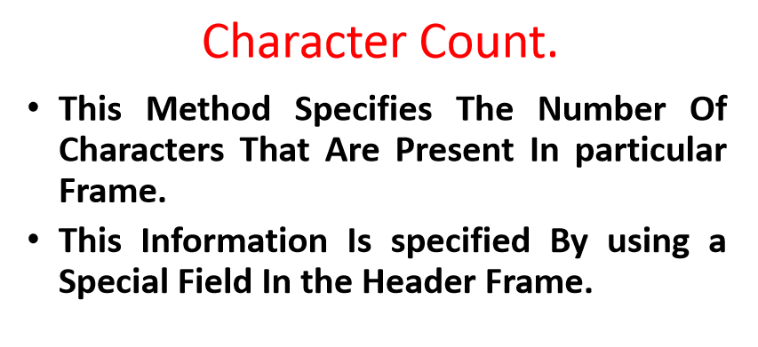

Slide 5
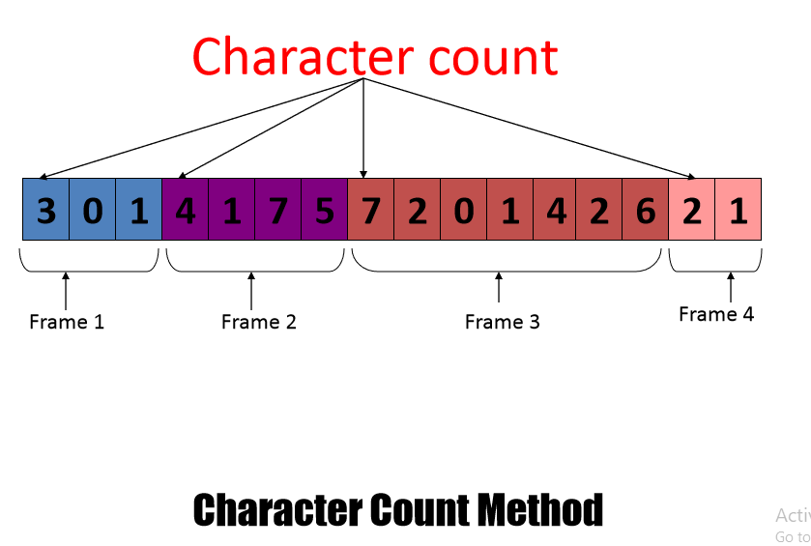

Slide 6
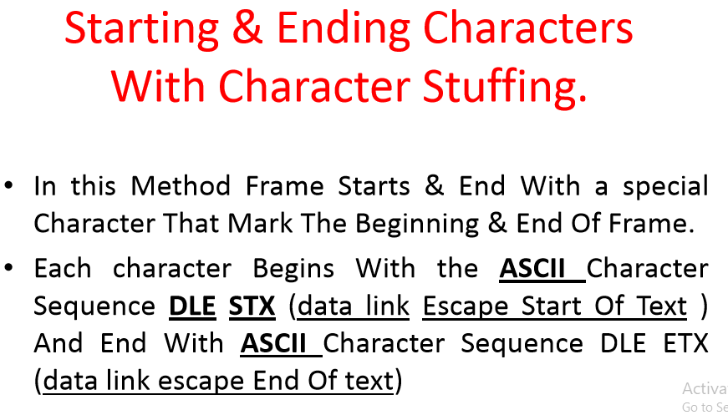

Slide 7
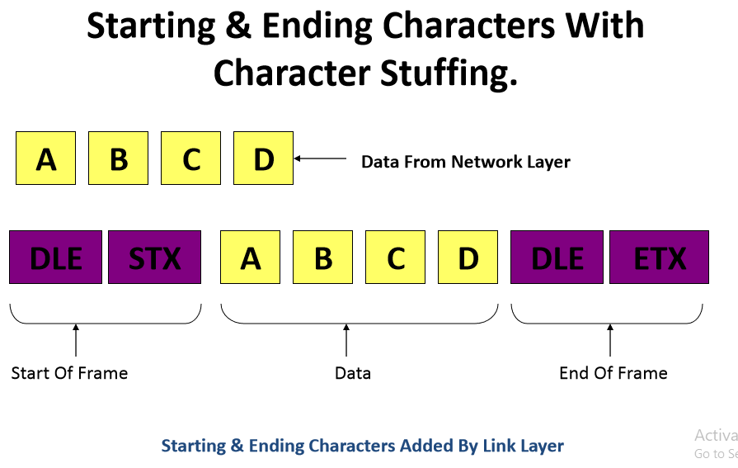

Slide 8
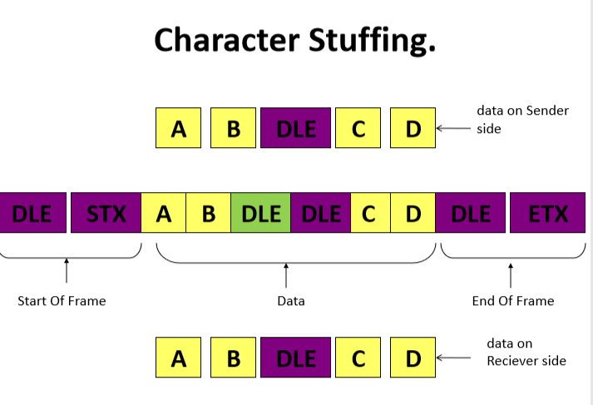

Slide 9
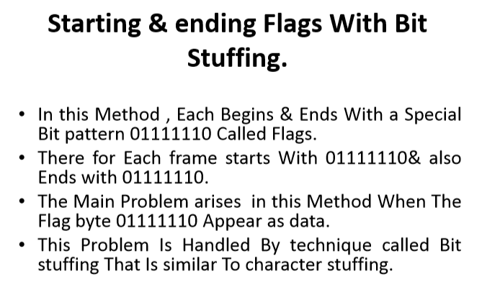

Slide 10
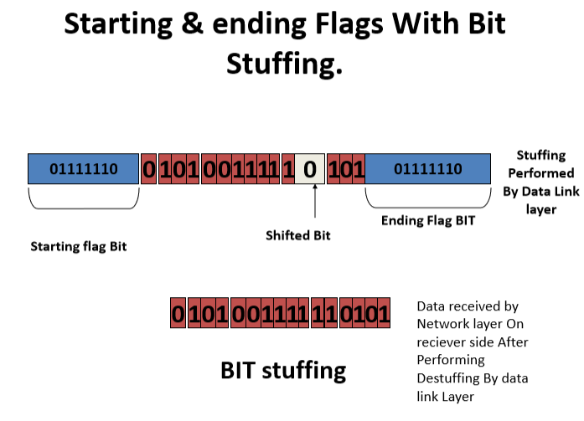

Slide 11
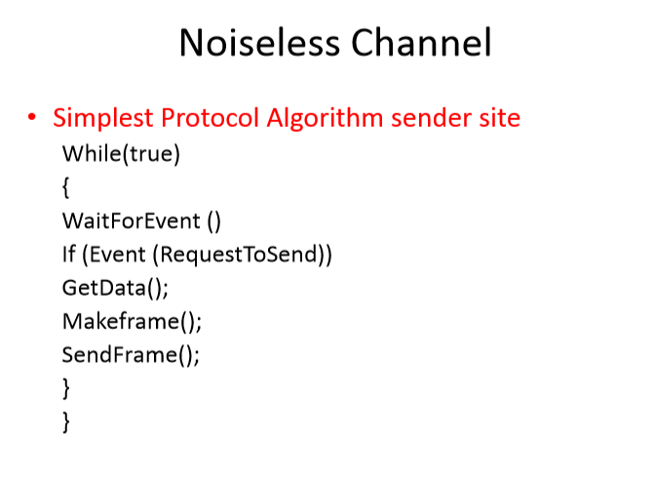

Slide 12
